Slide 1
BUDGET WEBINAR Teachers for EMRS
National Education Society for Tribal Students (NESTS), New Delhi

Slide 2
“You may be thinking that there are Mantras for students and parents but not for teachers. Well, who can give Mantras to teachers? They are the ones who give Mantras to society!”
- Hon’ble PM Narendra Modi

Slide 3
Staff Recruitment for Eklavya Model Residential Schools (EMRS)
In 2019, Government approved setting up of EMRS in every block with more than 50% ST population and at least 20,000 tribal persons.
740 EMRSs will be set up by 2025-26, which will benefit 3.5 lakh tribal students across the country.
Each school to get Rs.5.23 Crores annually for recurring expenditure @ Rs.1.09 Lakhs per student per year.
EMRSs are proposed to be centrally managed by National Education Society for Tribal Students on the line of Navodaya Vidyalayas.
As on date, 690 schools have been sanctioned and 400 EMRSs are functional benefiting more than 1.10 lakh students.
38480 teaching and non teaching staff will be recruited for 740 EMRSs.

Slide 4
Union Budget Announcement 2023-24
“Central Recruitment of Teachers for EMRSs – A total of 38,800 teachers and support staff shall be recruited in the next few years for the Eklavya Model Residential Schools which will benefit 3.5 lakh tribal students.”

Slide 5
Mechanism of Implementation
Each EMRS to have a total of 52 teaching and non-teaching staff as per CBSE norms.
38480 teaching and non teaching staff will be recruited centrally in a phased manner.
Centralized recruitment shall be carried out through CBSE .
In the Academic Year 2023-24, about 10000 teaching and non teaching staff will be recruited for 450 schools.
Central pay scales and service conditions for staff across all EMRSs.

Slide 6
Phase-wise staff requirement
Year | 2023-24 | 2024-25 | 2025-26 | 2026-27
Number of schools functional | 450 | 600 | 740 | 740
Teaching and non-teaching staff requirement | 19582 | 6224 | 9194 | 3480
Present availability | 5048 | 0 | 0
Net requirement | 14534 | 6224 | 9194 | 3480
Total |  |  |  | 38480

Slide 7
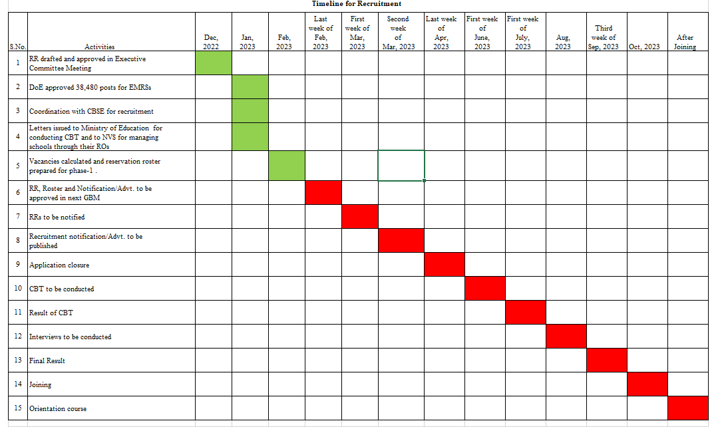
Timeline for Recruitment

Slide 8
Challenges
How to attract talented and quality teachers given the remoteness of schools.
Orientation and training of teachers to align them with the requirements of tribal students who are mostly first generation learners.
Capacity building of recruited staff.
High rate of attrition anticipated. Recruited teachers may prefer JNV/KVs and other options.
Problems of connectivity, medical facilities and other infrastructure in remote areas of schools.

Slide 9
List of Experts
Sl. No | Name | Designation (in case of retired person, position from which retired) | Sub-Theme
1 | Swami Anuragananda | Ramakrishna Mission Ashrama Sohra Cherapunjee, Meghalaya | Preparedness of teachers coming from diverse backgrounds
2 | Dr. Snigdharani Panda | Associate Professor & Chairperson Council of Deans, Kalinga Institute of Social Sciences | Recruitment challenges for remote locations
3 | Mr. Shaji A | Principal, Malleeswara Vidyanikethan Agali Attapadi Palakkad District, Kerala | Use of tribal language in primary education in tribal habitations
4 | Mr. Siddharth Yonzone | Principal, EMRS Gangyap | Challenges faced by teachers working in remote areas
5 | Ms. Vibha Joshi | Principal, EMRS Lumla | Preparing tribal children from Class 1 to 5 to enter Class 6th in EMRS
6 | Swami Pravakand | Bharat Sevashram, Ghatshila, East Singhbhum | Operational challenges for running schools in remote locations

Slide 10
List of Experts
Cntd...
Sl. No | Name | Designation (in case of retired person, position from which retired) | Sub-Theme
7 | Mr.Pragyan Sheth | EMRS Society- Chhattisgarh | Day to Day Issues and challenges in managing EMRS
8 | Smt. Nayana Gunde | Commissioner Tribal development Dept Maharashtra | Retaining teachers in remote areas .
9 | Ms. Anju Kauwr Chazot | Director and Founder-Mahatma Gandhi International School, Ahmedabad | Pedagogy for tribal students
10 | Sh. Samir Murasing | Deputy Director, Tribal Welfare Dept. , Tripura | Challenges faced by teachers working in remote areas
11 | Dr. Bobby Abrol | Program Manager -Tata Trust | Orientation and capacity building for EMRS tecahers.
12 | Sh. Suryakanta Bariha | Alumni of EMRS Odisha | Expectation of EMRS students from teachers in residential schools.

